Slide 1
Lecture 1: Introduction to Physical Design
Tsung-Wei (TW) Huang
Department of Electrical and Computer Engineering
University of Utah, Salt Lake City, UT
Notes:
Hello, folks, welcome to the physical design algorithms. This is a course to teach you fundamental algorithms for designing computers at a physical level. What I mean by physical level is to decide which component is placed at which position and how they are connected to each other, under various physical level constraints and objectives, such as minimum wirelength, minimum chip area, and optimal performance.

Slide 2
Logistics
Instructor: Dr. Tsung-Wei Huang (TW)
tsung-wei.huang@utah.edu
MEB 2124
Time: MoWe / 3 PM – 4:20 PM (excluding holidays)
In person: WEB L114
Zoom (back-up plan): https://utah.zoom.us/j/2468214418
Webpage
GitHub: https://github.com/tsung-wei-huang/ece5960-physical-design/
Office hour: by appointment
Notes:
I am the instructor, Tsung-Wei Huang. For convenience, you can just call me TW. Here is my email …

Slide 3
Scoring
Total 100 points
Four programming assignments of key physical design algorithms
Class presentation for important physical design algorithms
Academic integrity
You should always finish assignments by yourself!
I trust you but don’t take it for granted (it’s your career not mine…)
https://regulations.utah.edu/academics/6-400.php
Textbook
No need to buy any textbook
Slides will be available and are enough
Notes:
In terms of scoring, we will have four programming assignments that ask you to implement key physical design algorithms. The four programming assignments will be circuit partitioning, floorplan, placement, and routing. We will also ask you to give class presentation for important physical design algorithms, especially for those highly related to the four programming assignment. Each student will need to give two presentations talking about technical details and contributions of papers assigned to you.
You should always finish the assignment by yourself. I trust you but you should not take it for granted. Ultimately, it’s your career not mine. (expand …)
We will not have any text for the class. Slides are available on the github page and they are quite enough.

Slide 4
Class Philosophy
Learn important physical design algorithms
Combinatorial optimization problems (e.g., graph, discrete math)
Analytical methods (e.g., linear programming)
Program important physical design algorithms
Write C/C++/Python code to solve physical design problems
Implement various data structures and algorithms
At the end of the class, I want you to
Understand important computer design problems
Improve your coding skills and algorithm knowledge
Have more job opportunities in software companies (high pay today!)
Notes:
The class philosophy is as follows:
First, we will learn important physical design algorithms, including combinatorial optimization problems, such as graph, discrete math, and analytical methods, such as linear programming and optimization solvers.
Second, we will learn to program important physical design algorithms. This part goes to the four programming assignments that ask you to write C++ or python code to implement physical design algorithms, so you will understand how various data structures and algorithms play in physical design.
Finally, at the end of the class, I want you to understand important computer design problems, improve your coding skills and algorithm knowledge, and more importantly, have more job opportunities in software companies.

Slide 5
Programming Machines
Linux programming environment
Utah CADE Linux machine: https://www.cade.utah.edu/
Your personal MacBook, Linux desktop, etc.
Evaluation environment
Instructor’s server: twhuang-server-01.ece.utah.edu
Email the instructor (tsung-wei.huang@utah.edu) for an account with
Your account name
Your default password
Programming languages
No restriction but highly recommend C/C++
Notes:
In terms of programming assignment, you will be finishing them in Linux programming environment. Everyone should by default have an access to the Utah CADE linux machine. If you don’t, please go visit this website and you can apply for an account. You can also do the programming assignment on your personal macbook, linux desktop, and so on, if you have them.
For the final evaluation, you will need to upload your code to instructor’s server. Because I want to evaluate your assignment in a fair manner, this is where all you should submit your final solution.
You don’t have to do the account right now but by the end of the first programming assignment due, you should email me for an account with your account name and default password. That’s approximately three weeks from now.
In terms of programming language, there is no restriction but I highly recommend using C and C++. If you are not familiar with C++, this is a good time to understand how it works as it is very critical for your career.

Slide 6
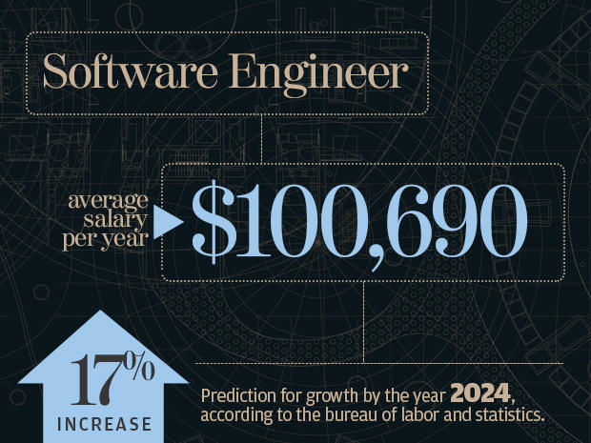
Why Programming…?
Notes:
Why are we doing programming? Well, you probably already know, software is a critical industry component in the US. The average number of the software engineer salary here in the US is actually very high. Looking at the salary review for software engineer in 2019, the average number is above 100K, and that was the number in 2019. The market has an average growth of 17%.
And I can give you an example based on my network as an alumni of UIUC, …

Slide 7

What Language?
Notes:
When it comes to software engineering or programming, students always have this question “which programming language to learn first”? Today, we have so many many many different languages, such as PhD, C++, C#, Bash, HTML, Javascript, etc. Which one is the best for me?

Slide 8
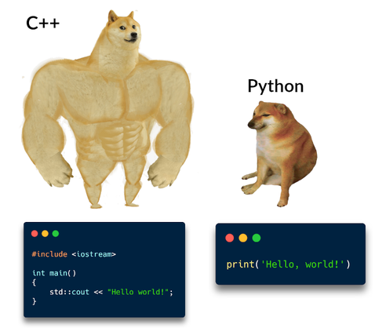
From my 10-year Programming Perspective
In general, your logic thinking matters the most
How to formulate a problem computationally?
How to solve a computational problem efficiently?
How to improve the solution quality programmatically?
However, as a CE/CS student, I highly recommend C++
C/C++ let you know how performance works
Software design patterns
Computer hardware and memory hierarchies
Python let you know how productivity works
Java let you know how portability works
Notes:
Well, language matters, but it is not the most important. From my 10-year programming perspective, your logic thinking matters the most. How to …
However, as a CE or a CS student, I highly recommend using C++ or mastering C++ at least in your programming career. Why? Because C++ lets you know how performance works? …
Next, you should learn Python which lets you know how productivity works.
If possible, you can also learn Java because it is another very popular programming language that teaches you to know how portability works.
Regardless of which language to learn, my experience tells me, once you master C++, pretty much all other languages are very easy to learn.

Slide 9
Silicon Compiler (Design Automation)
Hardware description (Verilog/VHDL)
Logic synthesis
Front end
Netlist (gate-level description)
Physical design
Back end
Layout (GDSII)
Notes:
Now, let’s move on to the course topic, physical design. Physical design is a very important step in the over computer design flow, you know, the flow we use to design a chip, an electronic product, and a computer.
Today’s design complexity is very high. For example, your smart phone can have tens of billions of transistors. It’s not possible to do this yourself or by hand. We have to relay on design automation tools or silicon compilers to help us design chips.
(explain the figure)

Slide 10
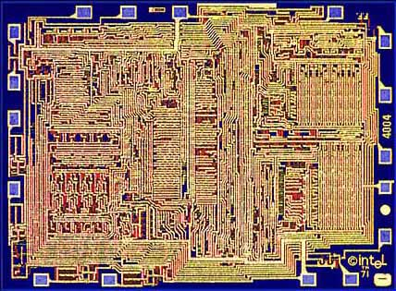
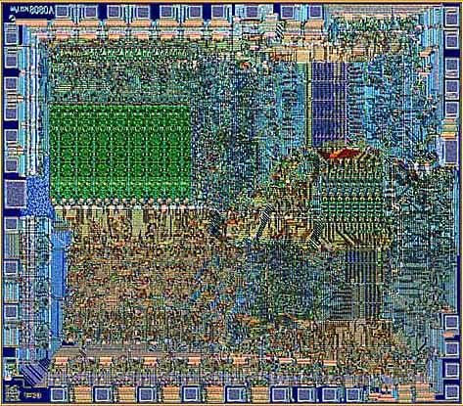
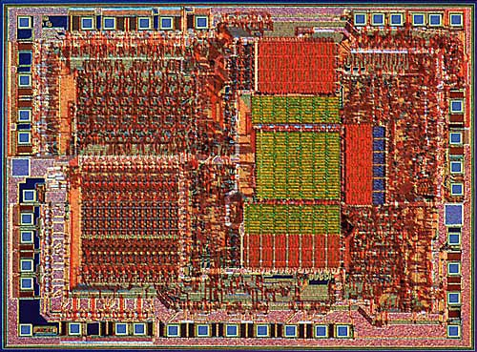
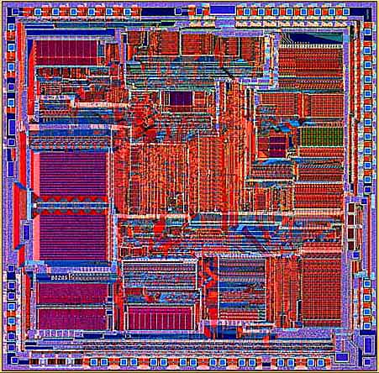
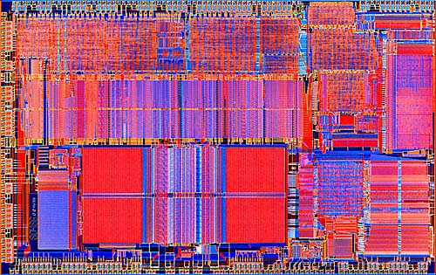
Why Silicon Compiler?
Intel 4004 (‘71)
Intel 8080
Intel 8085
Intel 8286
Intel 8486
Notes:
Why do we need silicon compiler or design automation tools? Well, like I said, it’s all about complexity. The chips we have today are just too complicated to design by hand. Looking at the Intel processor design, x86 series, billions of transistors in a very small chip area, trillions of wires connecting all these transistors together, and you have to make sure all those components are designed in a proper manner to optimize the performance, power, area, and timing. How do you do that without automation tools or silicon compilers? It is just not possible to do this by hand.

Slide 11
Silicon Compiler: Front-end
System Specification
Functional Design
X=(AB*CD)+(A+D)+(A(B+C))
Y=(A(B+C))+AC+D+A(BC+D))
Logic Design
Circuit Design
Notes:
The first stage or the front-end of a silicon compiler is logic synthesis. The idea of logic synthesis is to synthesize your logic into a set of connected gates. (explain the chart …)

Slide 12
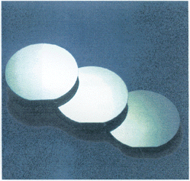
Silicon Compiler: Back-end
Physical Design
(Decide the layout)
Fabrication
Packaging
Notes:
After you have synthesized a set of connected gates, the second stage or the back-end of a silicon compiler is to decide the layout for those gates. For example, you have this NAND gate connecting to another OR gate implementing the give logic functions, now we have to decide proper locations for those gates. (explain …)

Slide 13





Physical Design Flow
Large amount of research opportunities!
Notes:
The physical design flow looks far more complicated than what we just explained. This is a very very very complicated stage. You start with a circuit that is synthesized to have billions of transistors, (explain …)
Because of the complexity, no single solution is optimal for all. There are large amount of research opportunities seeking novel solutions to solve important physical design problems, for instance, (explain …)

Slide 14
Complexity of Physical Design
More than 10 billion transistors
Performance driven designs
Power-constrained designs
Time-to-Market
Design cycle
……
High performance, high cost
Notes:
Again, the key reason to the large complexity of physical design is that we have large circuits. (explain…)

Slide 15
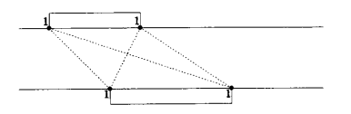
History of Physical Design
Born in early 60’s (board layout)
Passed teenage in 70’s (standard cell place and route)
Entered early adulthood in 80’s (over-the-cell routing)
Declared dead in late 80’s !!!
Found alive and kicking in 90’s
Physical Design has become a key force in design cycle
Thanks to the deep submicron scaling! We really need automation!
Thanks to algorithm innovations in computer science
Thanks to computer hardware advancement
Notes:
I want to talk a little bit about the history of physical design. Physical design was born in early 60 when the industry started with the simple board layout and PCB designs. Then, it passed its teenage in 70, when the industry started with standard cell design ideas that eventually bring us to placement and route. Then, it becomes quite popular in 80, but kinda disappeared in about 80. The reason is that most of the semiconductor design companies at that time didn’t believe in this idea of automation. Come one, I only have few thousands gates, why should I buy expensive software to help us design those layouts?
It turns out that was a huge mistake by the industry, when we moved on to deep submicro design in 1990. People begun to realize we really need automation tools to help us design circuits. Complexity is just becoming too large to afford non-automatic design styles.
Also, 80 and 90 were actually at the forefront of computing, right? We have many algorithm innovations coming out from the computer science, such as graph theory, dynamic programming, data structure, and so on. More importantly, the hardware advancement makes many computational problem possible to solve in a very efficient manner.

Slide 16
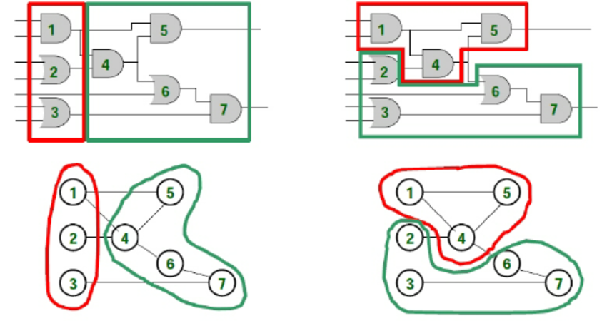
Circuit Partition Example
Which partition result is better?
Notes:
Let’s take a look at some physical design problems, and what they are actually doing. (explain …)

Slide 17
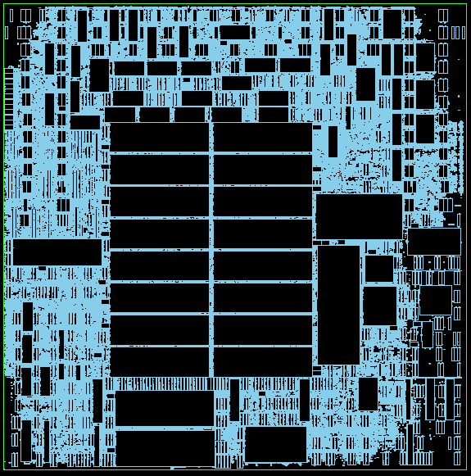
Floorplan Example
Many macros
Data paths + logic elements
I/O constraints
Area
Wire bond
Connection (e.g., gate 1 links gate 2)
…

Slide 18
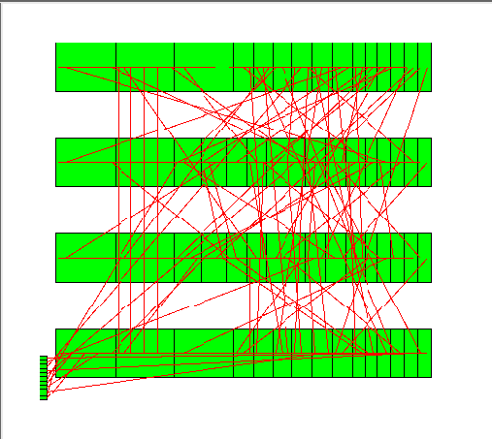
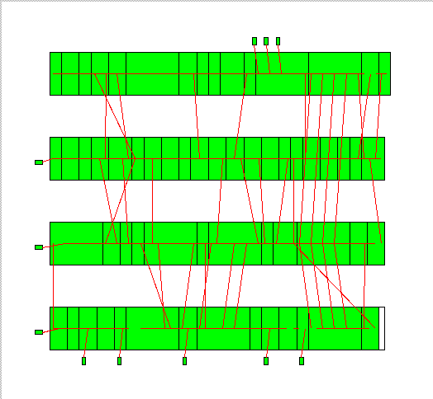
Placement Example
Which placement result is better?

Slide 19
Placement Example (cont’d)
Commercial tools are still away from optimal solutions …

Slide 20
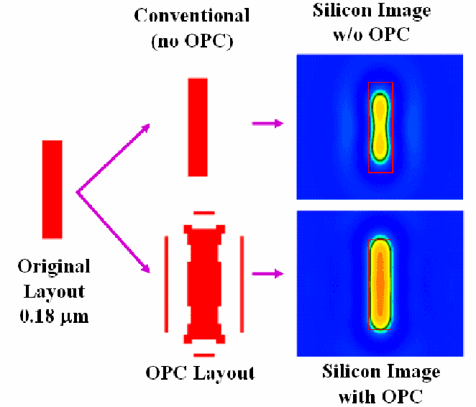
Lithography Example

Slide 21
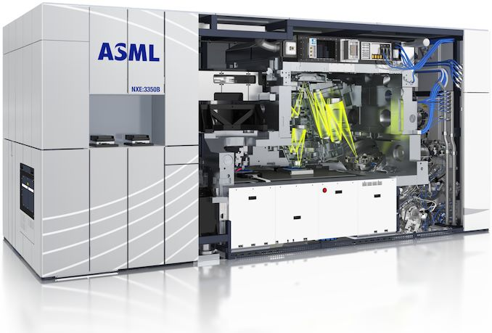
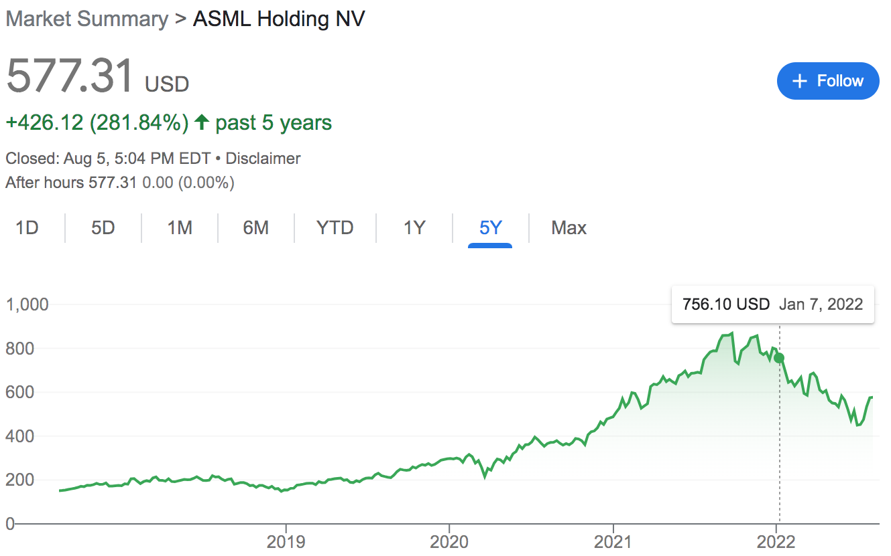
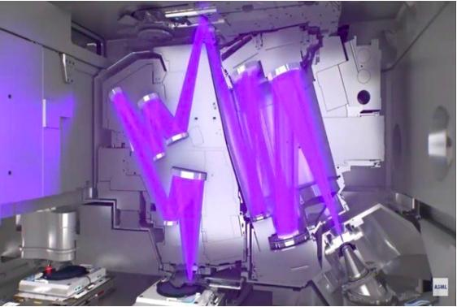
Lithography Example (cont’d)

Slide 22
Optical Proximity Correction (OPC)
More OPC friendly

Slide 23
Solving Physical Design Problems
To optimize design among different objectives, area, power, performance, and etc.
Fundamental questions: How to do it smartly?
Definition of algorithm in a board sense: A step-by-step procedure for solving a problem. Examples:
Cooking a dish
Making a phone call
Sorting a hand of cards
Definition for computational problem
A well-defined computational procedure that takes some value as input and produces some value as output
Notes:
Now we have see many different physical design problems and understood their importance, the next step is to learn how to solve them. In other words, we want to optimize design among different objectives, area power, performance, timing, etc.
Here is the fundamental question we want to answer: how do we solve physical design problems smartly? Well, we need algorithms! We need to formulate physical design problems into computational domains and solve them computationally.
The definition of algorithm (explain …)

Slide 24
Computational Problems
Decision problem
Given a positive integer n, determine if n is prime
Search problem
Find all even numbers in X=[1,2,3,4,5]
Counting problem
Given a positive integer n, count its number of nontrivial prime factors
Optimization problem
Given a graph G, find an independent set of G of maximum size
…
Course objective: How do we solve these problems smartly?
Notes:
This slide shows you some computational problems. For instance, we have decision problem, given a positive integer, tell me if that number is prime.
(explain…)
With computational problems in place, the key course objective is to learn algorithms to solve them smartly.

Slide 25
Example: Big Mod Problem
Computational problem description
Input: a, b, c (3<a, c<5000000, 1<b<2147483647)
Output: x = a^{b} (mod c)
A simple solution
for(i=1, x=1; i<=b; i++)
x = (x*a)%c;
std::cout << “a^b % c = ” << x << std::endl;
Notes:
To understand the meaning of “solving a problem smartly,” let’s take a look at an example, the very famous Big Mod problem. The computational problem description has the following input and output requirements: (explain …)

Slide 26
Example: Big Mod Problem
Computational problem description
Input: a, b, c (3<a, c<5000000, 1<b<2147483647)
Output: x = a^{b} (mod c)
A simple solution
for(i=1, x=1; i<=b; i++)
x = (x*a)%c;
std::cout << “a^b % c = ” << x << std::endl;
Is the solution smart enough?
We need a total of “b” iterations
Very slow execution for large b
Very frequently asked interview questions!!!
Notes:
Turns out this is a very frequently asked interview questions by big software giant companies, like Amazon, Google, Meta, MS… If you provide that solution for this question, you will never move on to the next stage of the interview.
So, the next question is, is this loop-based simple solution smart enough? (explain)

Slide 27
Refined Solution (Recursive)
Input: a=2, b=15, c; Output: x = a^{b} (mod c)
Simple solution needs a total of b=15 iterations
Let’s refine the iteration count recursively
2¹⁶ = ( 2⁸ )² total 1 calculation
2⁸ = ( 2⁴ )² total 1 calculation
2⁴ = ( 2² )² total 1 calculation
2² = ( 2¹ )² total 1 calculation
2¹ = ( 2⁰ ) total 1 calculation

Slide 28
Refined Solution (Recursive) (cont’d)
#define SQUARE(x) (x*x)
int bigmod(int a, int b, int c) {
if(b==0) return 1;
else if(b%2==0)
return SQUARE(bigmod(a,b/2,c)%c)%c;
else return ((a%c)*bigmod(a,b-1,c))%c;
}
int main() {
int a,b,c;
while(std::cin >> a >> b >> c) std::cout<<bigmod(a,b,c)<<endl;
return 0;
}
2¹⁶ = ( 2⁸ )² total 1 calculation
2⁸ = ( 2⁴ )² total 1 calculation
2⁴ = ( 2² )² total 1 calculation
2² = ( 2¹ )² total 1 calculation
2¹ = ( 2⁰ ) total 1 calculation

Slide 29

Refined Solution (Iterative)
int bigmod(int a, int b, int c) {
int result = 1;
while(b > 0) {
if(b & 1) {
result = (result * a) % c;
}
b = b >> 1;
a = a*a%c;
}
return result;
}

Slide 30
Runtime Comparison
https://www.onlinegdb.com/
Runtime (with –O2) – Enabled Optimization
(a, b, c) | Naive | Refined (recursive) | Refined (iterative)
(2, 1000000, 3) | 13720 us | 24 us | 22 us
(2, 10000000, 3) | 136148 us | 9 us | 4 us
(2, 100000000, 3) | 1320049 us | 8 us | 4 us
Notes:
This table compares the runtime among the three different methods under three different b values. On the first row here, I have b equal to 1M, … (explain)

Slide 31
Code Analysis
https://godbolt.org/z/6zT4cK3Wz
 | Naive | Refined (recursive) | Refined (iterative)
Lines of C++ Code | 7 | 11 | 11
Lines of Assembly (-O0) | 55 | 99 | 59
Lines of Assembly (-O2) | 27 | 57 | 32
Notes:
The next question we want to ask is what is the difference between the recursive solution and the iterative solution for the refined algorithm? We know both implement pretty much the same algorithm idea to reduce the iteration number in an optimal manner. What is the difference between them?
This is also a very important lesson you should always ask yourself when writing code to implement algorithms. You can implement this algorithm recursive or you can implement this algorithm iteratively without any recursion. Which one should you pursue?
The best way to understand this is to see what the machine actually sees your code. All the code we have written is designed to be high level or, human-readable. The code we just wrote is not what the machine actually sees. To reveal the secret behind the code, we can go to the website, compiler explorer, and see what the compiler does for us to generate machine code that executes the code we wrote. (explain)

Slide 32
Magic behind the Refined Solution
In fact, there is a name for the refined method:
Divide and Conquer (D&C) algorithm
(used to solve >50% large and complex computational problems, e.g., Google Map, sorting, etc.)

Slide 33
D&C is Widely used in Physical Design
Modern circuits sizes are too large to handle in a flat fashion
42M transistors
1.5MHz; 224 mm²
Directly solving the original problem takes forever to finish …
Notes:
Divide and Conquer is heavily used in many physical design algorithms. Modern circuit sizes are just too large to handle in flat. If you do this, it means handling billions of transistors at one time. You have no hope to finish it in a reasonable amount of time.

Slide 34
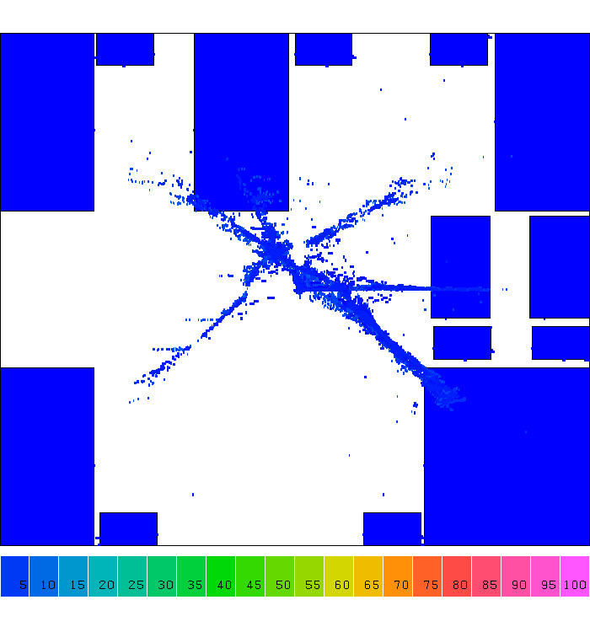
Example: D&C-based Placement
Notes:
Let's take a look at an important physical design application of divide and conquer, placement. A placement is a step that tries to find the location of each gate, you know Or gate, NAND gate, NOT gate, and other gates, in a chip area. And we have billions of gate to place in a rectangular area.
Physical design tools don’t do placement in a flat manner, or it can be too complicated to solve at one time. They do this in divide and conquer. (explain)

Slide 35
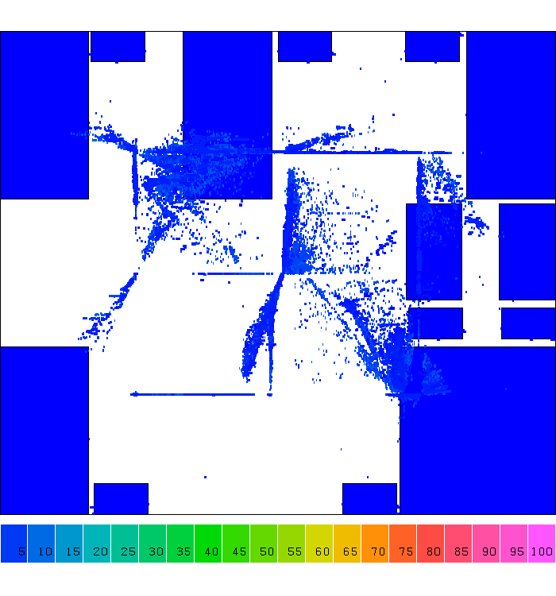
Example: D&C-based Placement

Slide 36
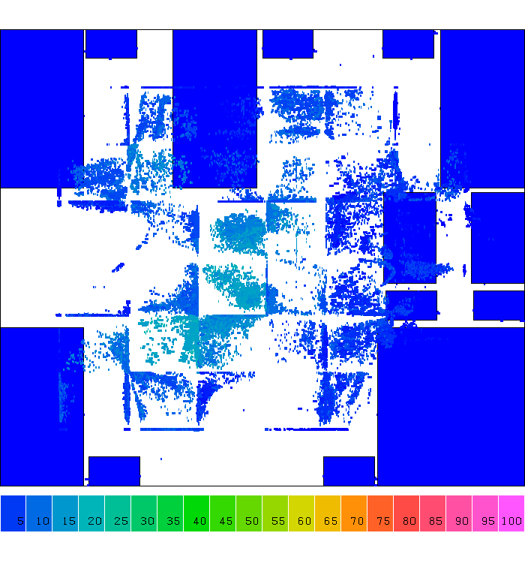
Example: D&C-based Placement

Slide 37
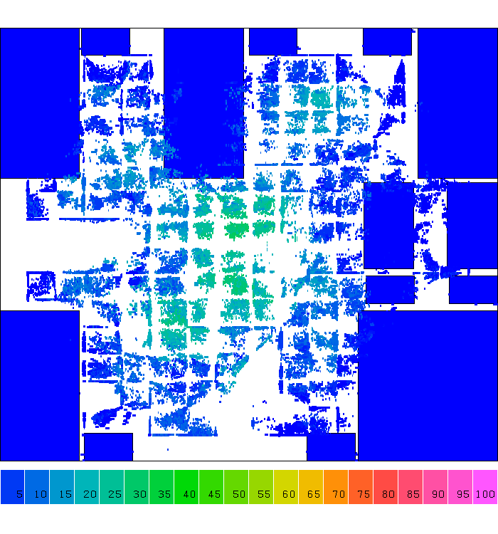
Example: D&C-based Placement

Slide 38
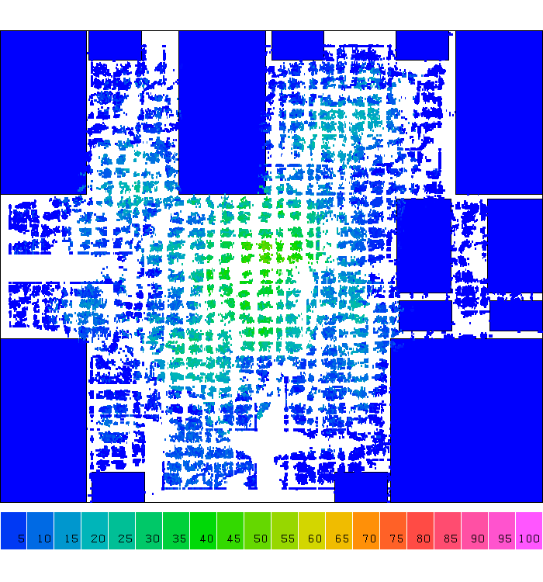
Example: D&C-based Placement

Slide 39
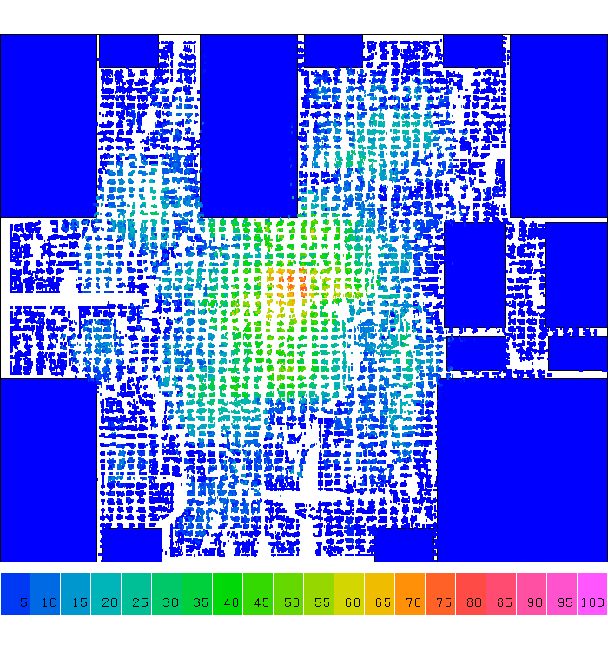
Example: D&C-based Placement

Slide 40
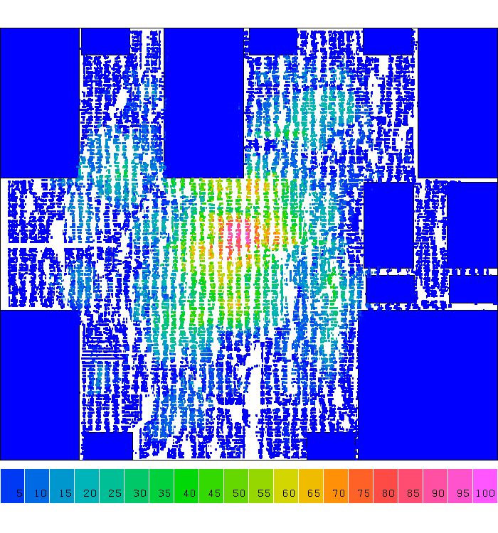
Example: D&C-based Placement

Slide 41
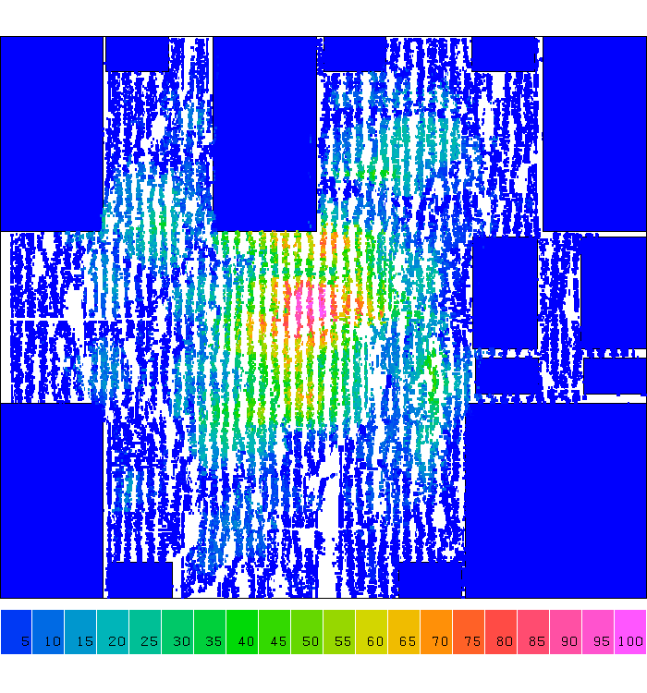
Example: D&C-based Placement
Notes:
So, from iteration to iteration you can clearly see cells are placed very regularly, right, Cells are spreading along the 2D grid partition. We partition the large chip care into smaller grids and place cells in those small grids. Solving the smaller grid problem is definitely more efficiently than directly handling the original problem.

Slide 42
Summary
We have discussed class logistics
We have discussed design automation flow
We have discussed physical design
We have discussed concept of computational problems
We have discussed a computational problem example
Problem formulation
Naïve solution
Refined solution
Practical code analysis techniques

